Slide 1

Lecture 2
Recap
Quantum states & Dirac notation
Unitary evolution & Quantum gates
Proving No-cloning theorem
Quantum circuits

Slide 2
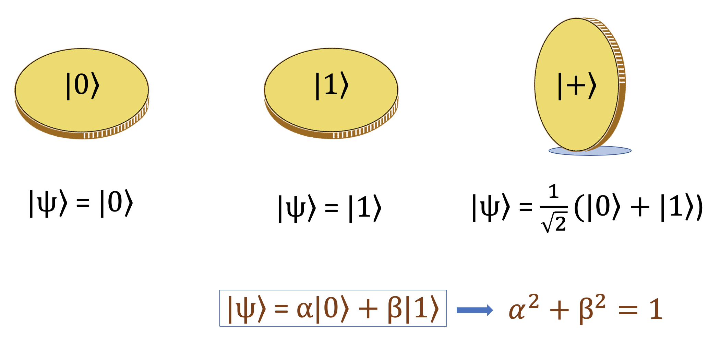
Recap: The Qubit

Slide 3
Recap: Exponentially large state space
Encoding information with physical systems
qubits
Complexity explodes exponentially
electrons/atoms/photons etc.
Not directly accessible, hard to simulate with any classical machine
Number of possible configurations and amplitudes
Total # of atoms in the universe:
# of qubits to saturate the whole universe’s computational resources:

Slide 4
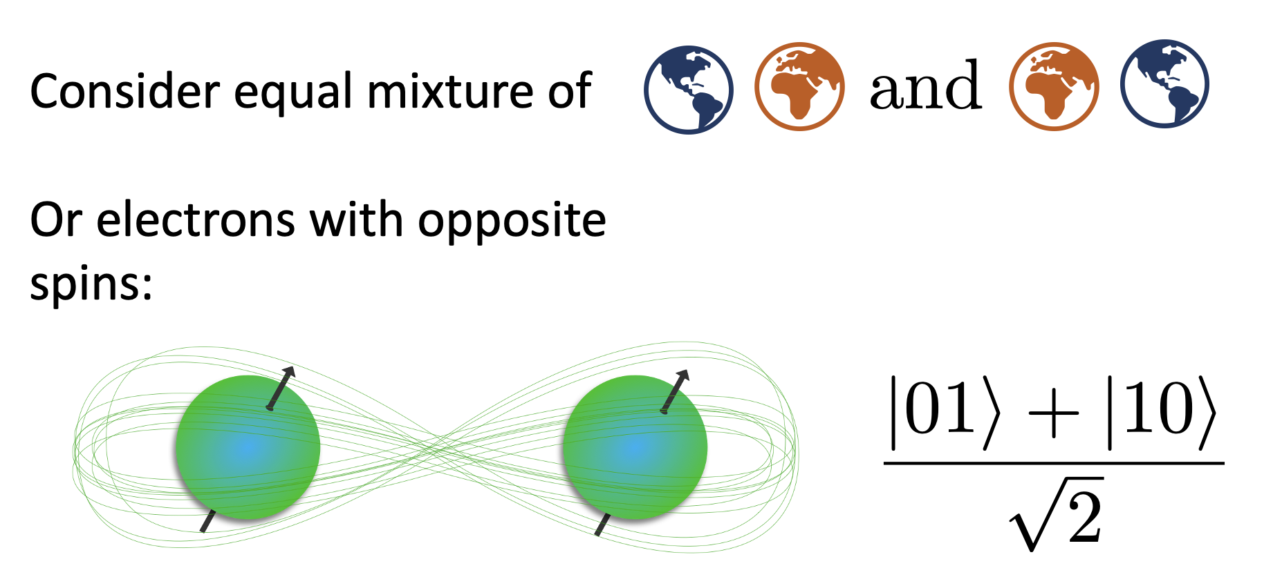
Recap: Entanglement

Slide 5
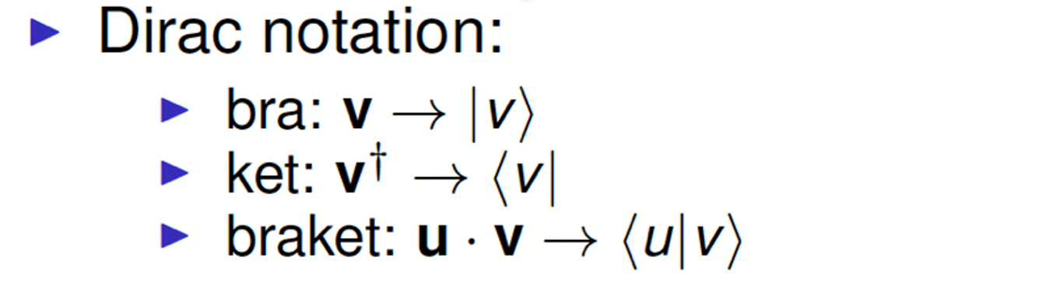
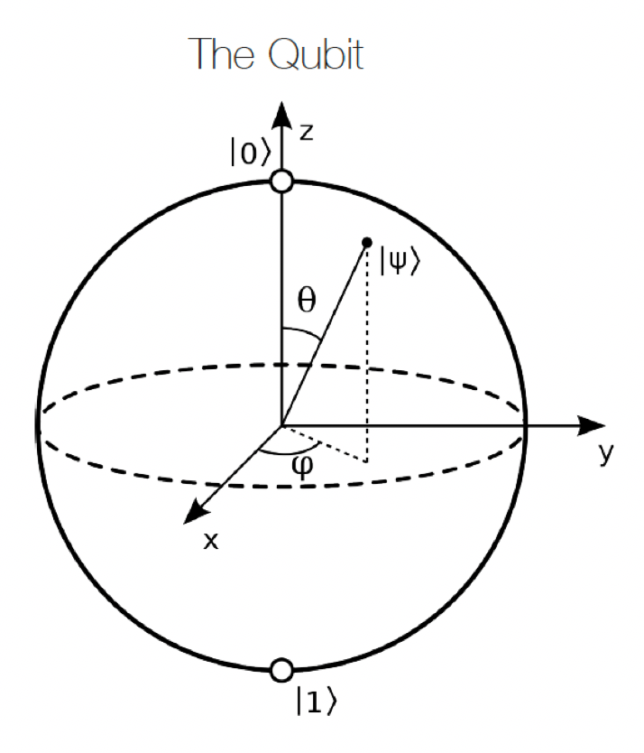
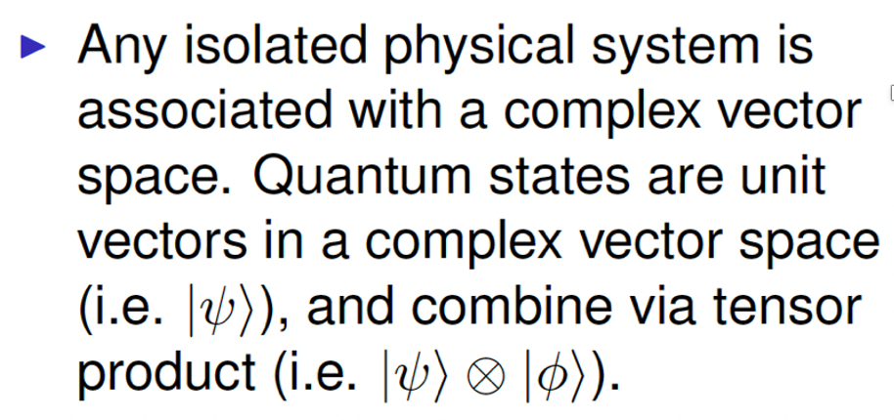
Quantum State as Complex Vector

Slide 6
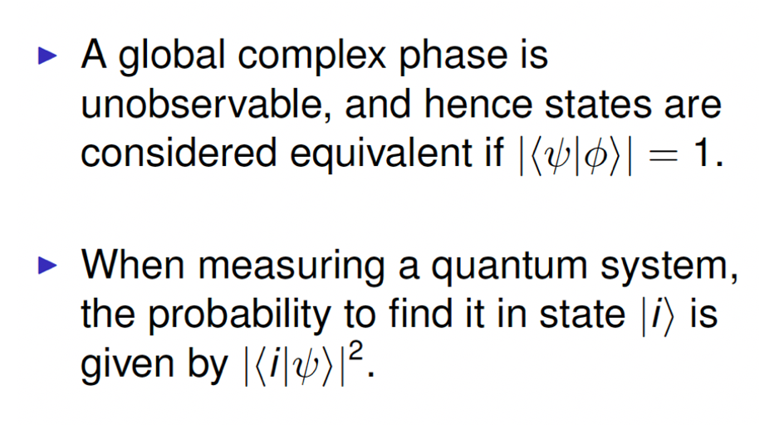
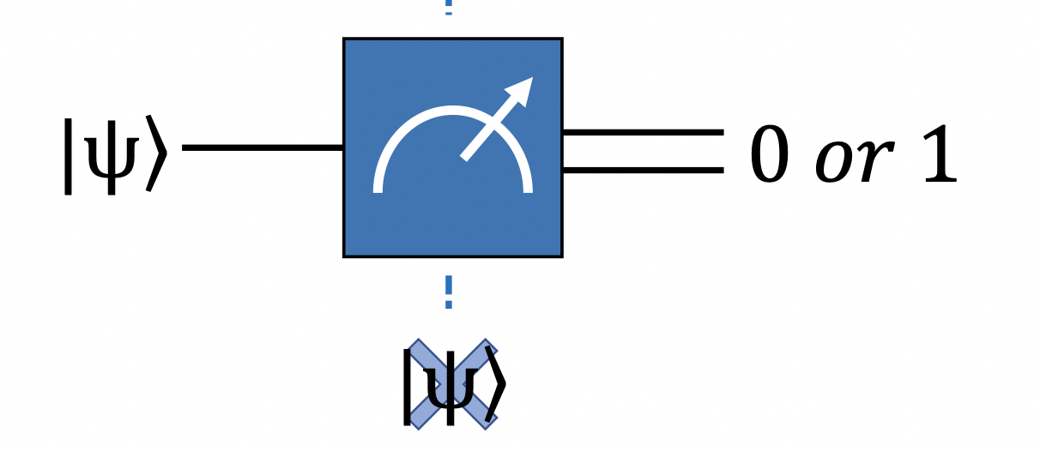
Measurement on Quantum States

Slide 7
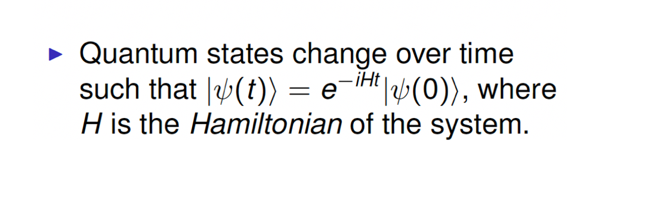
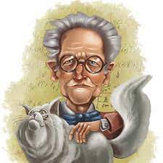
Unitary Evolution of Quantum States
Unitary evolution is a reversible logic

Slide 8
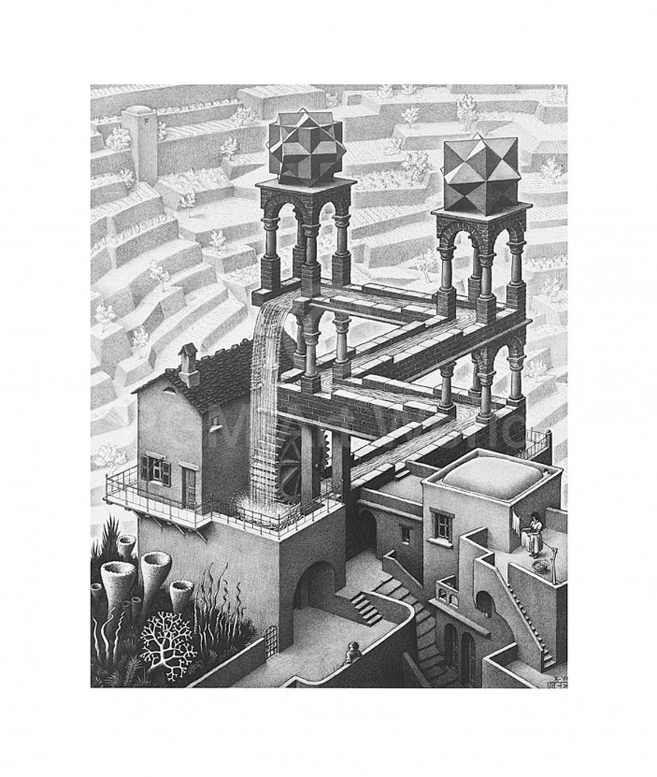
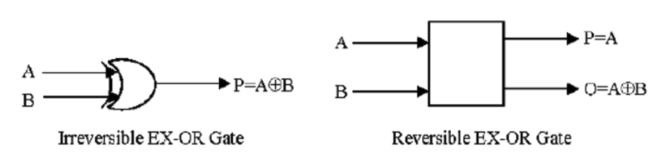
Unitarity, Reversibility and Efficiency
Reversible logic is a computing paradigm in which there is a one to one mapping between the input and the output vectors
Reversible logic gates consume their input have no more inputs than outputs
Quantum computing is thermionically analogous to a Carnot engine.

Slide 9
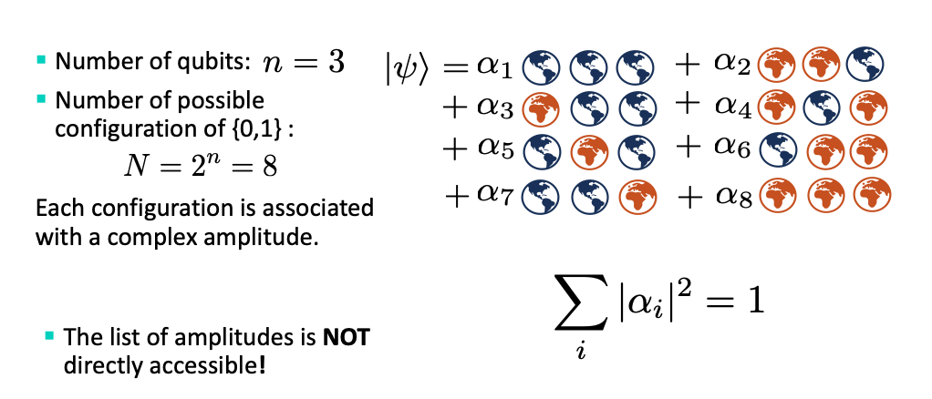
3-Qubit Illustration recap

Slide 10
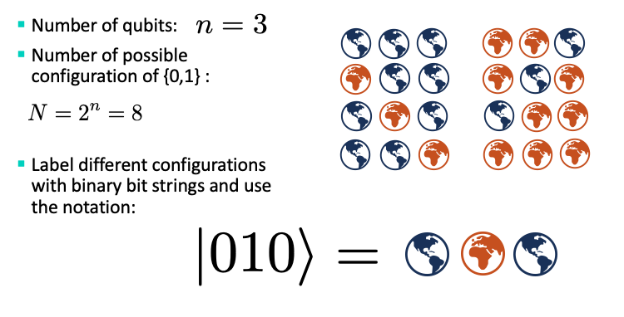
3-Qubit Illustration continued

Slide 11
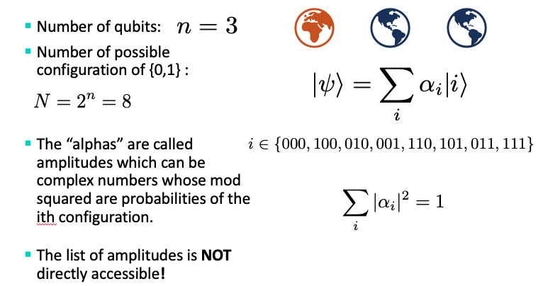
3-Qubit Illustration Continued

Slide 12
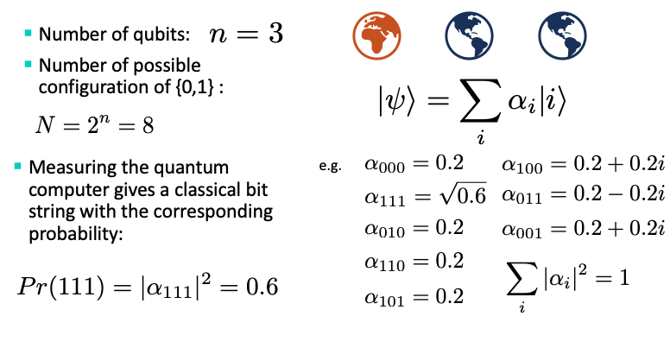
3-Qubit Illustration Continued

Slide 13
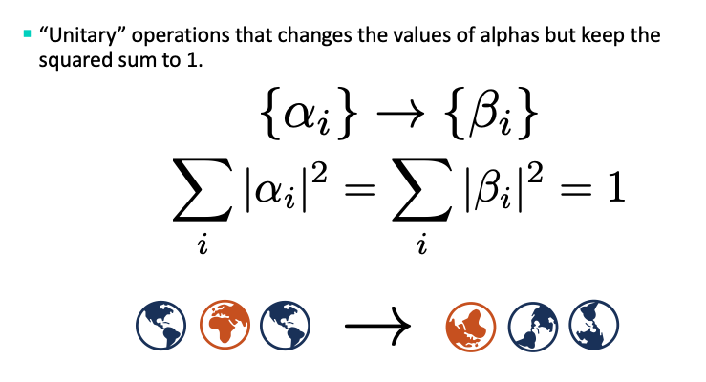
3-Qubit Illustration Continued

Slide 14

No-Cloning Theorem
Suppose there exists a universal quantum copy machine that can make copy of any quantum state

Slide 15
No-Cloning Theorem
Consider its respective action on two arbitrary quantum states

Slide 16
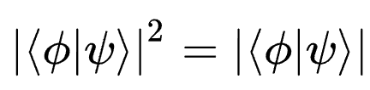
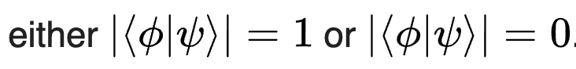
No-Cloning Theorem
=1
Implying
Implying
But this isn’t true for any arbitrary pair of states!
(only so if they are the same or orthogonal )

Slide 17
THEREFORE
DOES NOT EXIST!

Slide 18
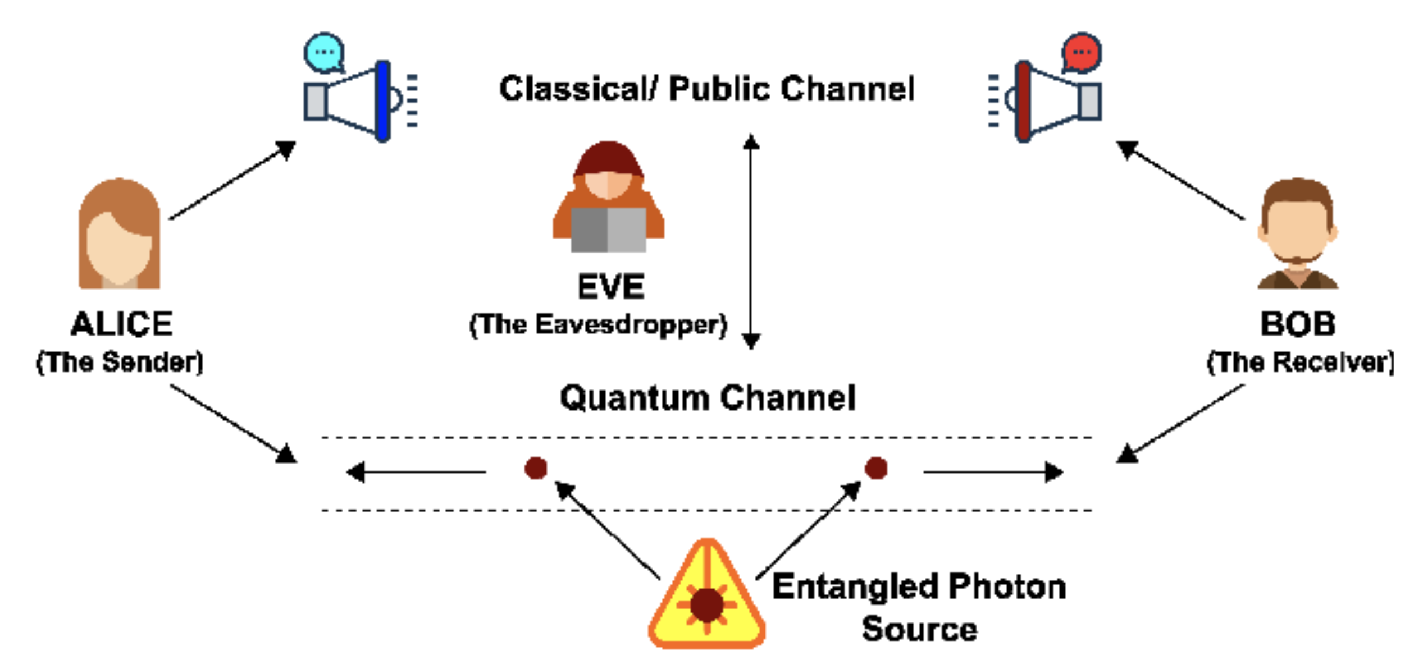
No-Cloning Theorem: Application
Putting together shared entanglement and no-cloning: Information theoretically secure quantum key distribution

Slide 19
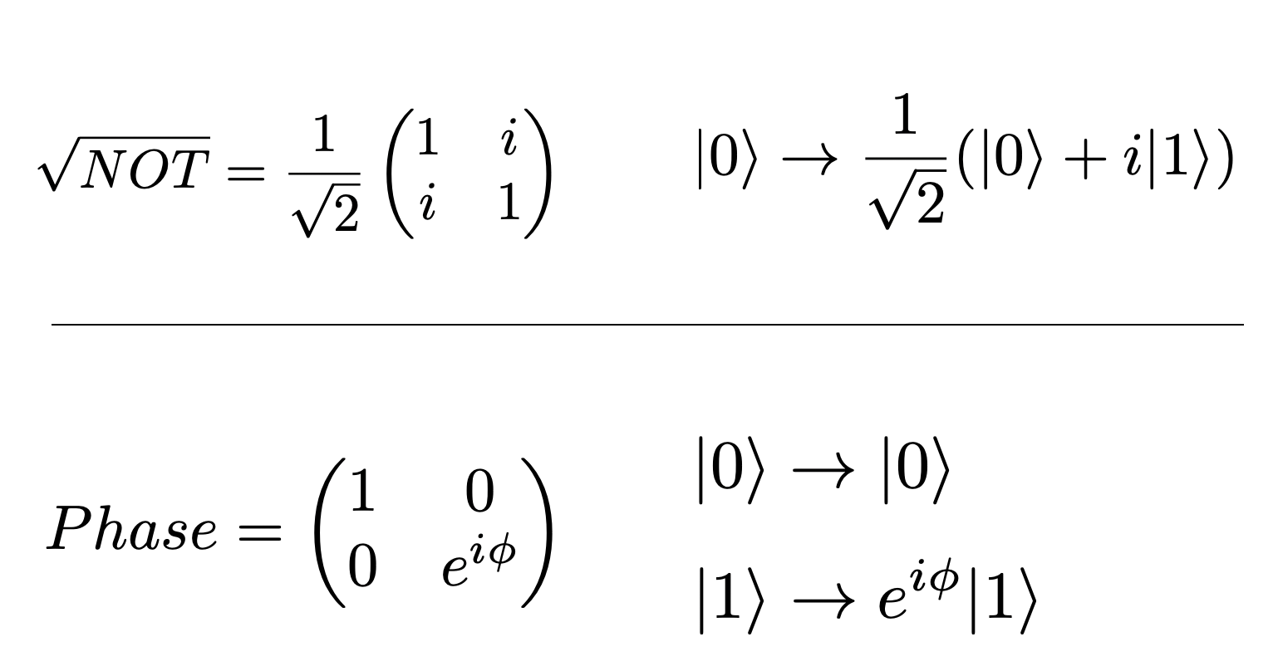
Quantum Logic Gates

Slide 20
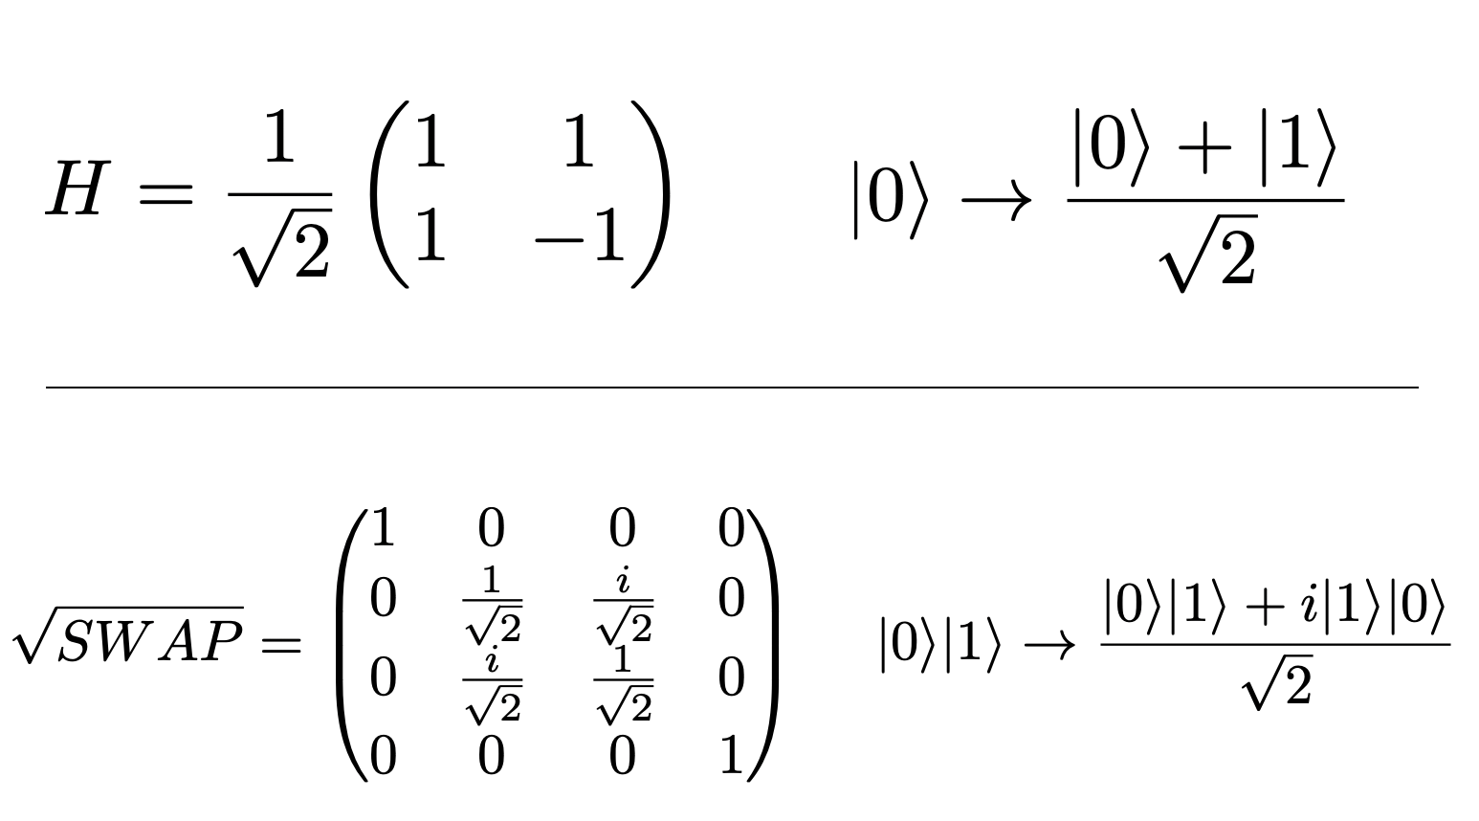
Quantum Logic Gates

Slide 21
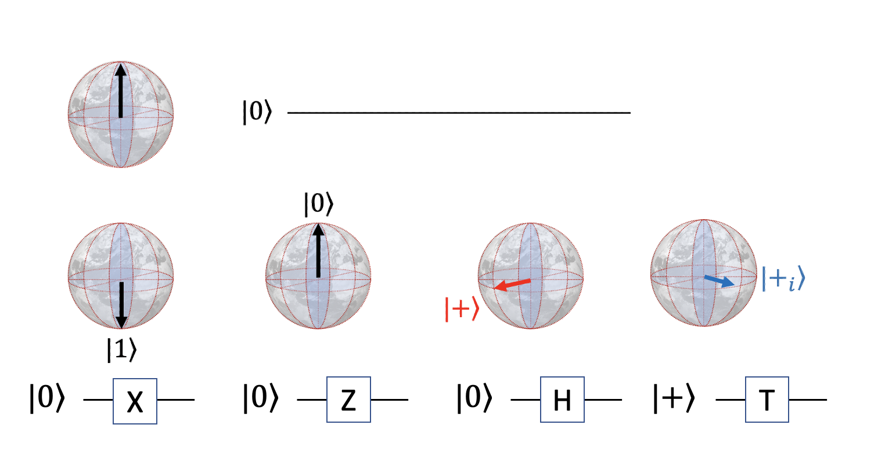
Quantum Circuits: Building Blocks

Slide 22
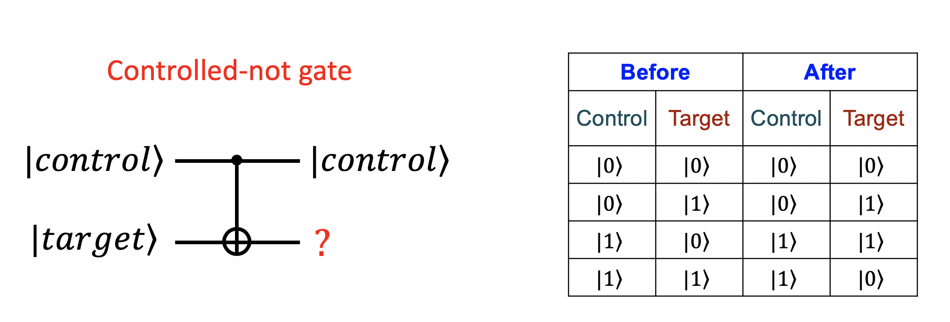
Entangling gate: Controlled-Not

Slide 23
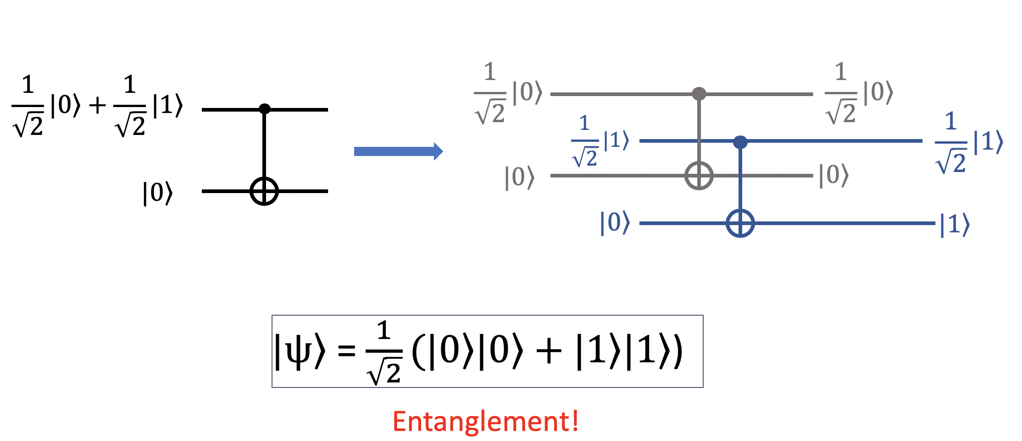
Entangling gate: Controlled-Not

Slide 24
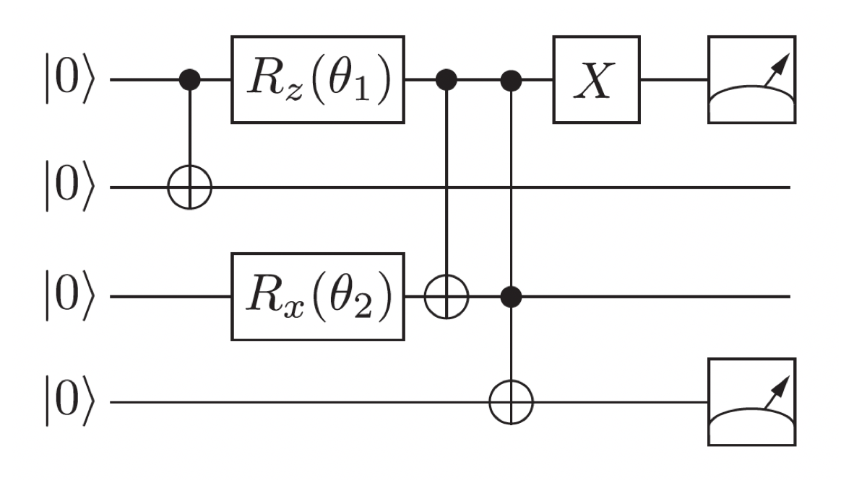
Quantum circuit example

Slide 25
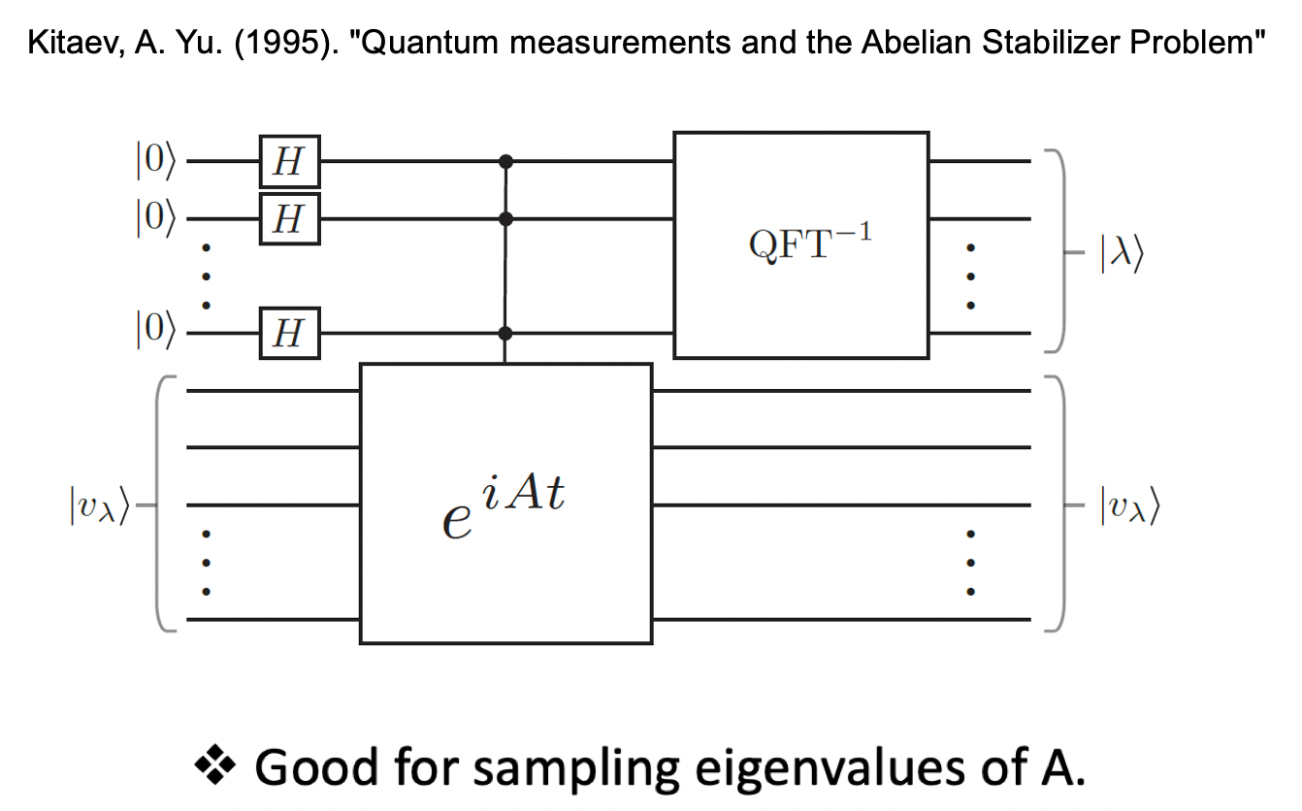
Quantum circuit example

Slide 26
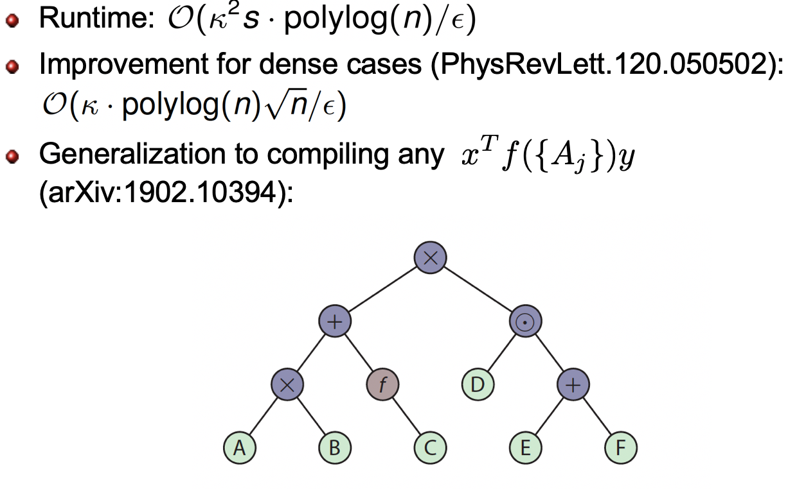
Example Application: fast linear algebra

Slide 27

To be continued…
Quantum machine learning models and application (QSVM, QGP, QNN etc. )
More on quantum algorithms

